Slide 1


Exploratory Data Analysis
GOLD ATLANTIS: REPAYING THE CREDIT
By: Kalyan Chatterjee

Slide 2
Objectives :-
Understanding the Dataset
Analysing the dataset for finding the chances of an applicant becoming defaulter
Drawing inferences from the patterns
Providing suggestions for the inferences

Slide 3
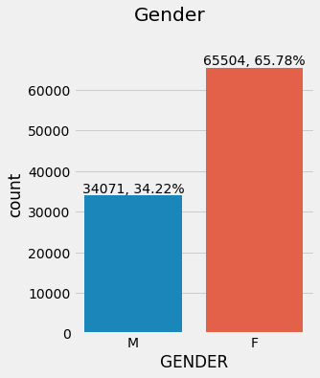
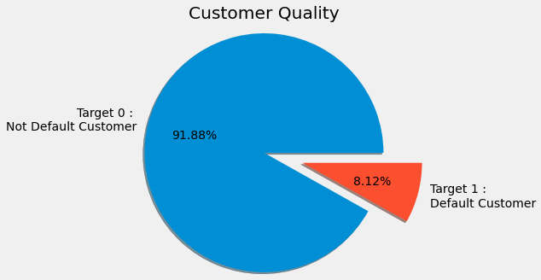
Male Applicants:34071 (34%)
Not Default Applicants: 91485 (92%)
Total Credit amount for Loan = Rs. 596 Billion
Total Applicants: 99575
Default Applicants:8090 (8%)
Female Applicants: 65504 (66%)
Average Credit amount for Loan = Rs. 5,98,882
Understanding The Data
Total Credit amount disbursed to Defaulter’s account = Rs. 45 Billion (13% of Total Credit Amount)

Slide 4
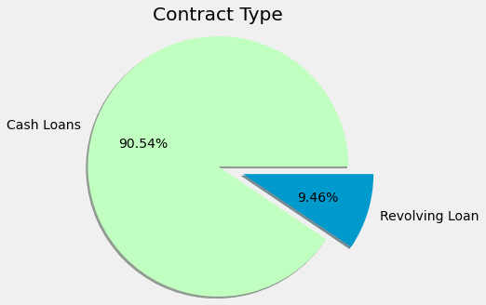
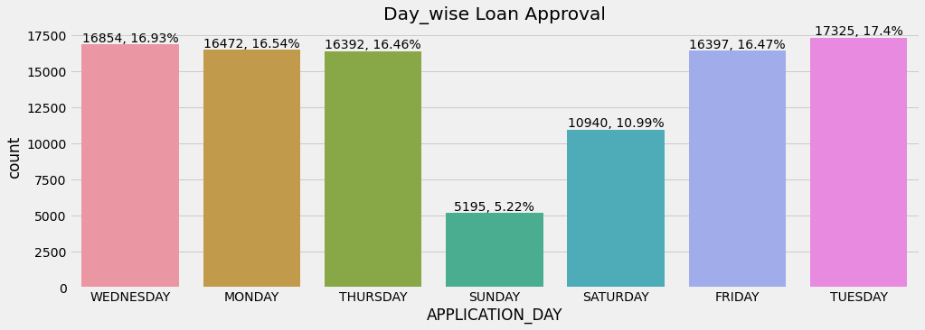
90.5 % of Total applicants have taken Cash Loan or Personal Loan
9.5 % of Total employees have taken Revolving Type Loan such as by Credit Card.
69% of all the applicants owns at least a house
Understanding The Data
Whereas, 34% of all the applicants owns at least a personal Car
Maximum Credit amount of the loan for a client is 31.5 lakhs
Clearly apart from weekends throughout the week the number of application is almost uniform

Slide 5
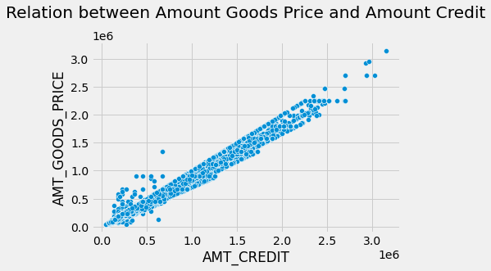
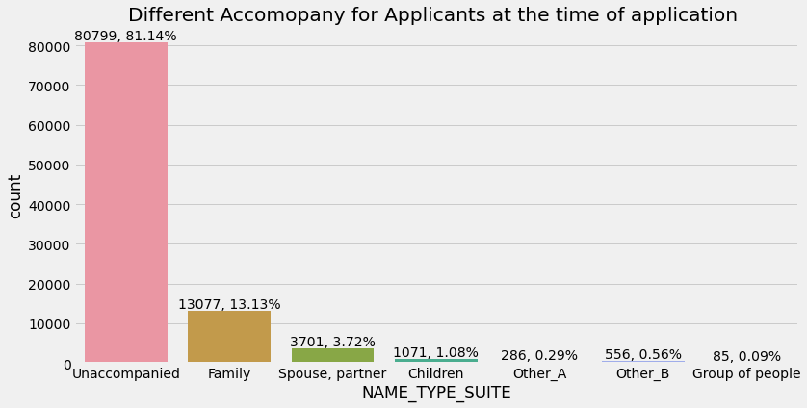
The price of the goods for which the loan is given is increasing with increase in Credit amount.
The Value of Coefficient of correlation is 0.986.
Understanding The Data
81% of the applicants arrived the firm for credit alone at the time of application.

Slide 6
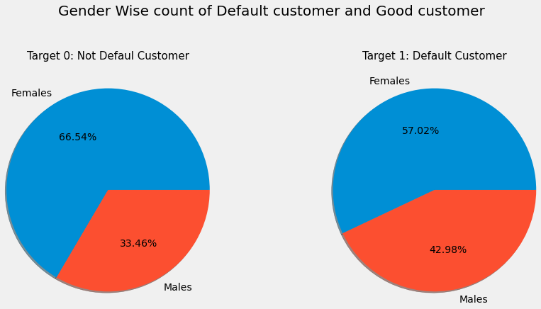
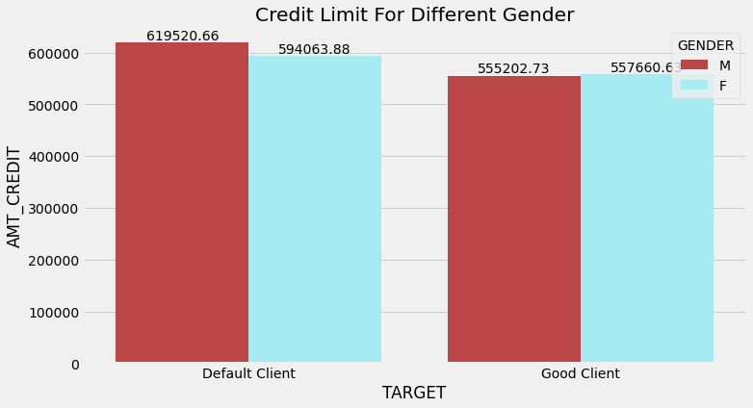
For Not default customers 66.5 % are Female but for defaulters the percentage gets reduced to 57%
99.85 % defaulter’s Mobile phone is in reachable condition.
Firm can communicate with them and send them follow up notification for upcoming instalment.
Let’s Analyze
Average Credit amount for Male Defaulters is MORE than Female Defaulters
Whereas, Average Credit amount for Female good client is Slightly MORE than Male good clients.

Slide 7
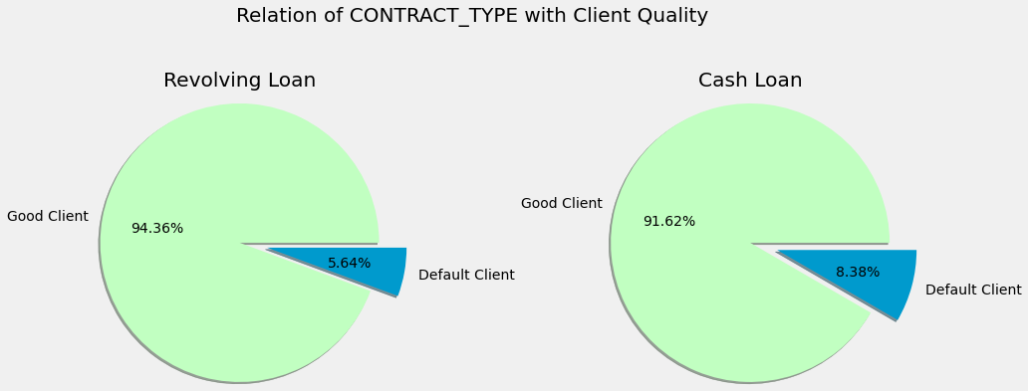
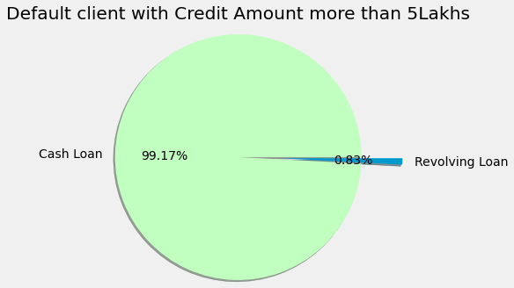
Among All the applicants of Revolving loan, 5.86% are defaulters
Among All the applicants of Cash loan, 8.38% are defaulters.
Let’s Analyze
Clearly, The chances are MORE for an applicant of a Cash loan to become a defaulter than that of an applicant of a Revolving loan
99% Defaulters with Credit Amount more than 5 Lakhs are applicant of CASH Loan.

Slide 8
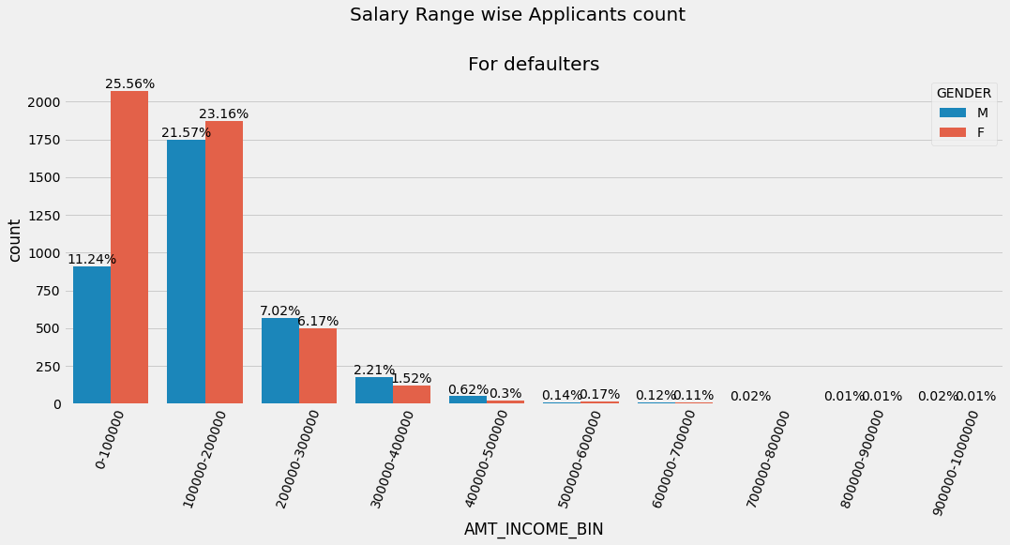
95% of client having credit amount less than Rs. 1500000
Average Credit amount for female applicant is 5.91 lakhs
Average Credit amount for male applicant is 6.13 lakhs
Let’s Dig Deeper
Average Credit amount for female defaulter is 5.57 lakhs
Average Credit amount for male defaulter is 5.55 lakhs
The Females with salary less than 2 lakhs are like to become defaulters.
Where Males with salary more than 2 lakhs are more likely to become defaulters

Slide 9
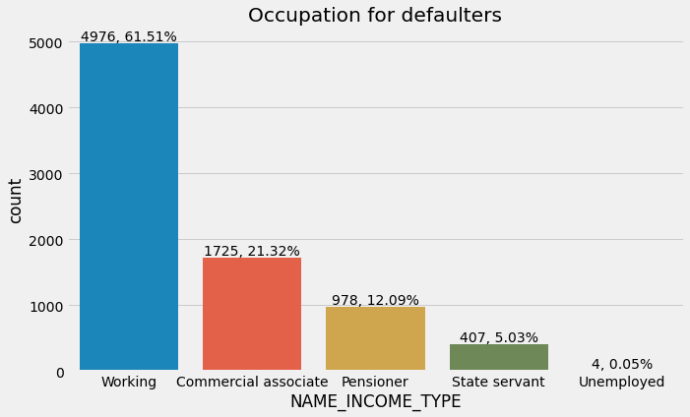
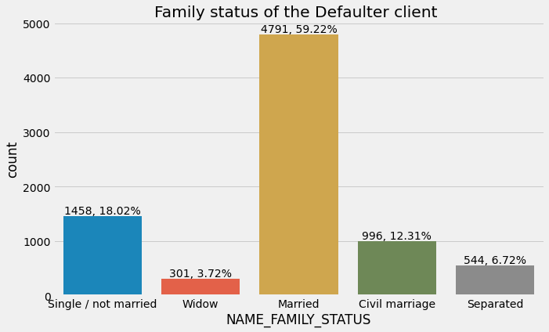
61.5% of Defaulters are Working. Whereas only 0.05 % defaulters are unemployed.
Possibly because unemployed client’s Loan approval mostly gets denied.
Let’s Dig Deeper
59% of Defaulters are Married. Mostly due to family urgency he/she is late in paying installments more than once.
Only 18% of single Defaulters are Single

Slide 10
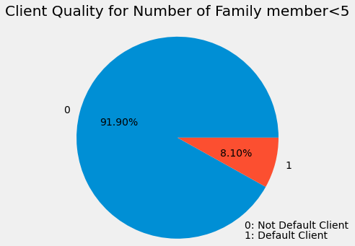
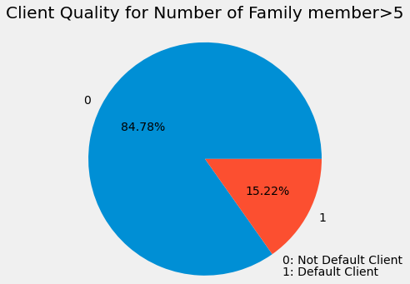
For applicants with Family member < 5, 8.02% are having payment difficulties i.e. 1 out of every 12 applicants, having Family member < 5 is a Defaulter.
Let’s Dig Deeper
For applicants with Family member > 5, 15.22% are with payment difficulties i.e. 1 out of every 6 applicants, having Family member > 5 is a Defaulter.
Probably because of Family Requirement they delayed their installments

Slide 11
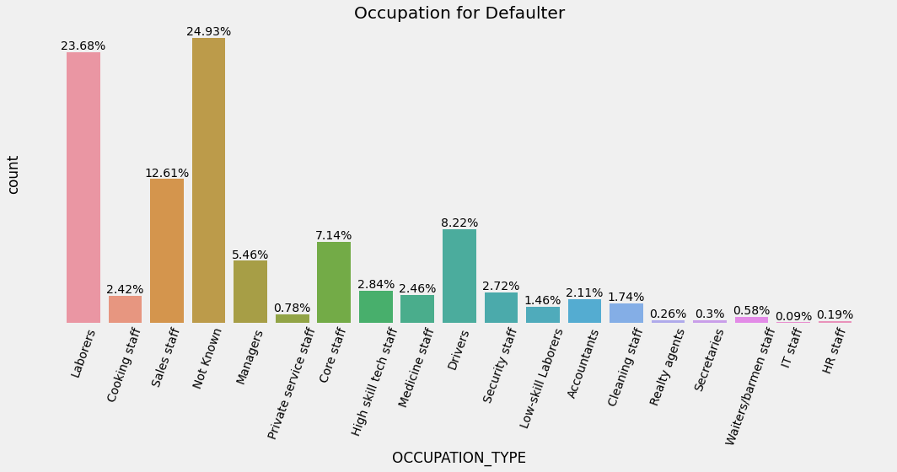
Let’s Dig Deeper
Exact occupation for 25% of defaulters are unknown.
This is a big loop hole from firm’s point of view as with out inspecting properly credit has been transferred.
24% of defaulters are Laborers. This is mostly because of the current pandemic situation many laborers have lost their Jobs and facing financial crisis.

Slide 12
Inferences:
An applicant of a Cash loan have higher chance of becoming an defaulter than a applicant of revolving loan
1 out of every 6 applicants, having Family member > 5 is a Defaulter.
25% of default client's occupation is unknown.
Majority of the of Defaulters are Married.
Suggestions:
Inferences & Suggestions
Firm should promote Revolving loan more. Also, for credit amount more than 5 lakhs firm should approve Revolving loan only.
Firm should inspect all the submitted documents minutely for applicants with family member >5
The Firm is advised to be strict towards not giving credit approval to applicants with out details of their respective occupation
Firm can issue some cashback rewards for timely paying for installment

Slide 13
References:
Python Workbook Gitlab link: Python Codebook
Data Set Link : Gold Atlantis Dataset
Data Dictionary: Gold Atlantis Data Dictionary
Additional Source: Kaggle_Website

Slide 14

Thank You !!
Address: Asansol, West Bengal
Mobile : 6290594393
Mail ID : kalyanchatterjee84@gmail.com

